Slide 1
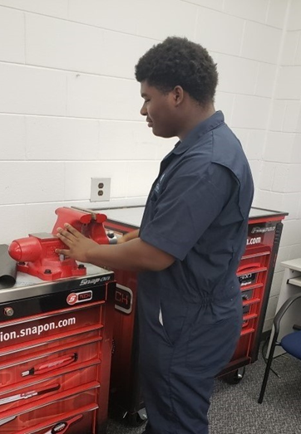
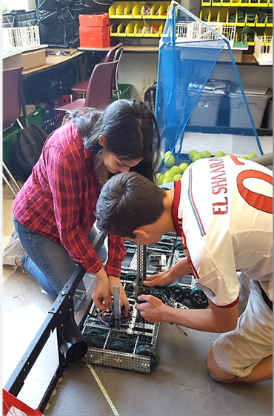
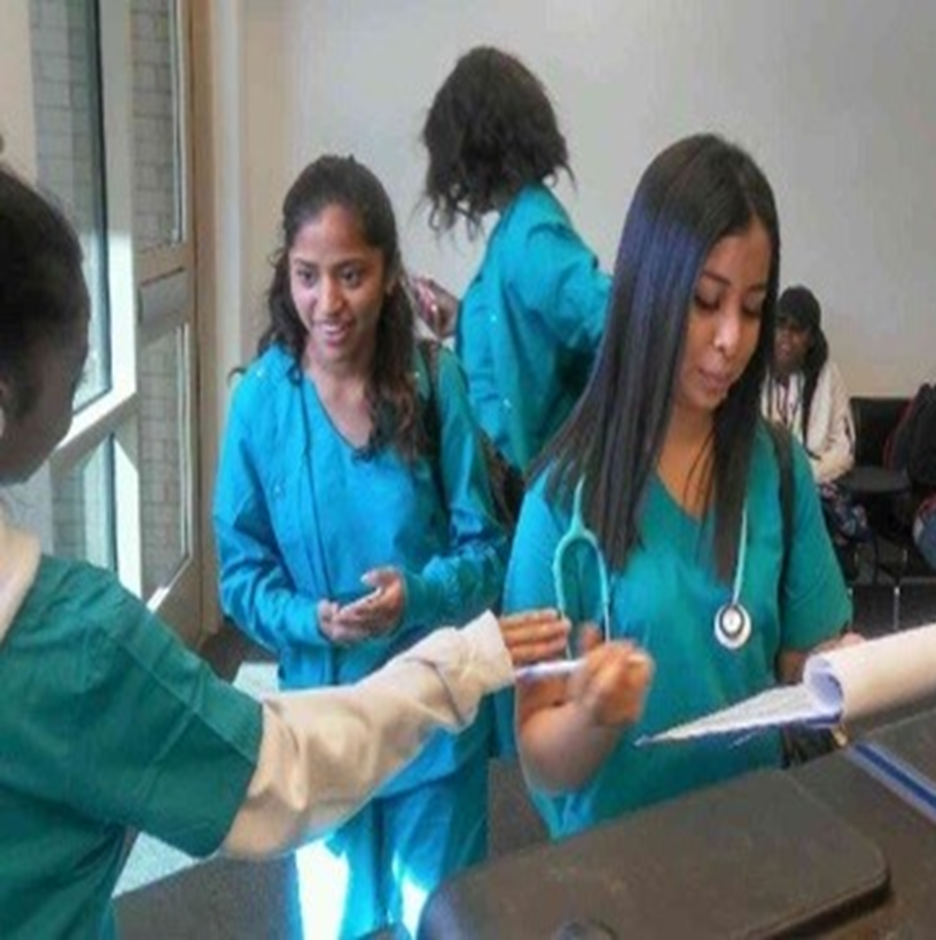
Virtual Open House
August 20, 2020
1 p.m.

Slide 2
Dr. Tasharah Wilson, Principal

Slide 3
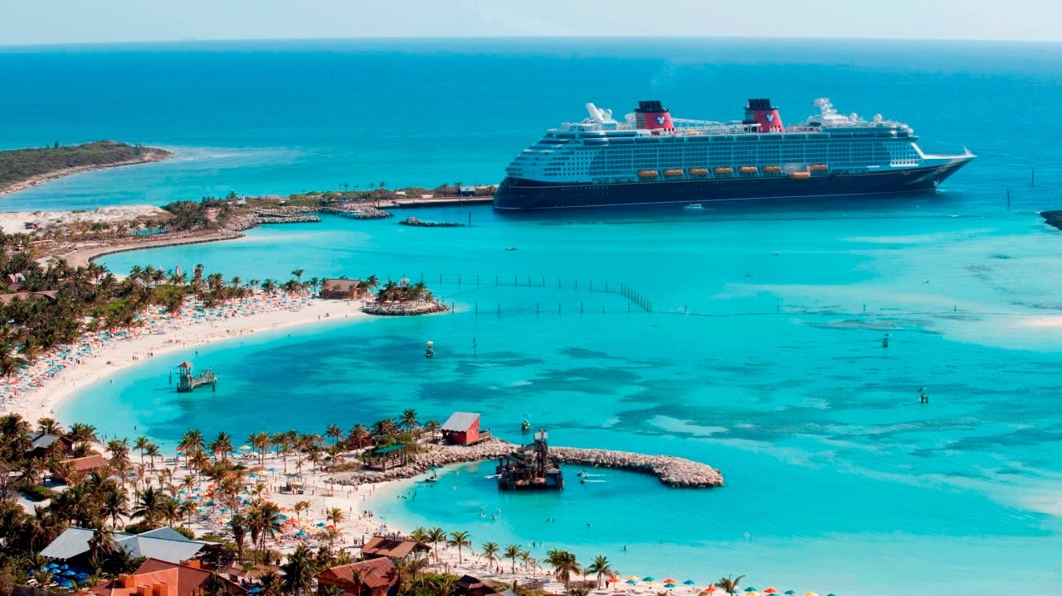
Hospitality, Recreation & Tourism Pathway
This Photo by Unknown Author is licensed under CC BY-SA-NC
Presenter:
Nicole Champion
3

Slide 4
I’m excited to be your teacher!
Born in Mahattan, NY; raised in Miami, FL; moved to Atlanta area 2004
American and Jamaican-European descent
3 children (2 boys and 1 girl)
Graduated from Florida A&M University (FAMU-HBCU) with MBA
Previously worked in Retail and Hospitality industry
18 years of teaching experience (Miami, Fulton, Cobb)
Interest in Marketing started in HS and with DECA
Favorite color – green; favorite desert – key lime cake
Love to travel ex. Japan

Slide 5
Exciting Facts about Hospitality, Recreation & Tourism Pathway
Students will develop a leadership perspective about social, environmental, economic and consumer factors impacting the HRT industry.
Career options: Airline Pilot, Hotel Manager, Event or Travel Consultant
Possible median salary: $121,000, $54,000, $50,000, $40,000
What makes this an exciting career? If you love to interact with people and you’re sociable, you love to travel and see different cultures, people and taste various foods.

Slide 6
Exploration of Hospitality, Recreation & Tourism Pathway
What special projects will we complete? Event Planning Project; Professional Selling & Consulting Project; Integrated Marketing Campaign; Career Development Project
What experiences will we have? Watching travel videos, virtual reality videos, industry chats, case studies, etc.
What will make this pathway exciting? Exploring different aspects of the pathway, earning industry certifications, etc.

Slide 7
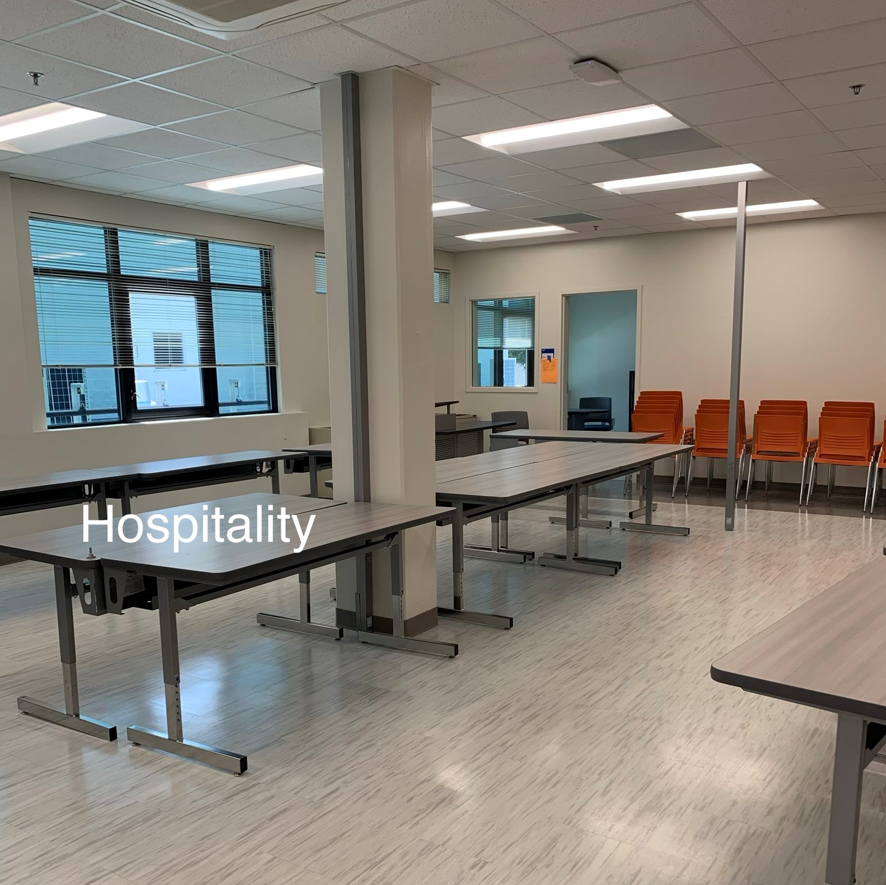
Exploring Our Lab
Computers, printers, chairs, tables
Will create promotional ads, design PowerPoint projects, utilize different online sources
Students will explore the foundations of Marketing during the first course ex. 7 Functions of Marketing, 4 Ps of Marketing, etc.

Slide 8
Instructional Expectations

Slide 9
College & Career Counseling Department

Slide 11
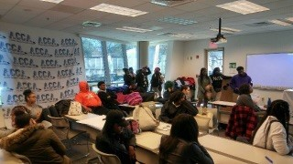
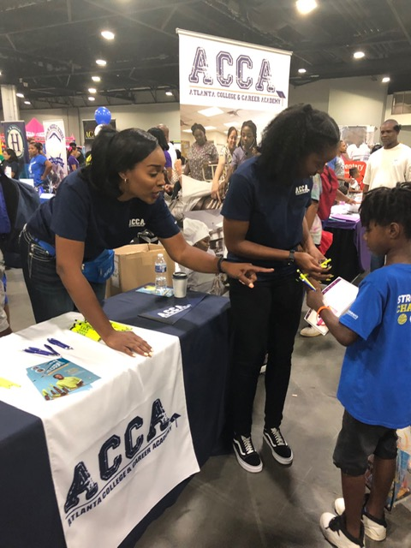
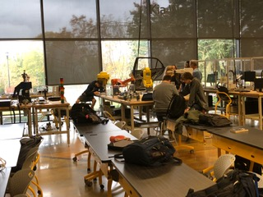
11

